Slide 1
xTuple Business Intelligence: Improve your Profitability and Operational Excellence with xTuple Analytics

Slide 2


Why Business Intelligence
ERP helps you operate your business
Business transaction management.
Operational reporting.
ERP + BI helps you measure and understand your performance.
Key indicators to measure performance.
Historical analysis with emphasis on trends.
Looking at data from different points of view.

Slide 3
How BI Helps Improve Performance
Revenue Enhancement
The right opportunities, customers products, territoroes, partners, etc.
Efficiency
Sales pipeline time and volume.
Order fullfillment.
Cost Reduction
Cost & margin analysis of customers, products, territories, etc.

Slide 4
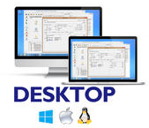
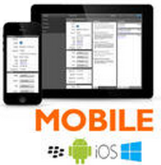
xTuple BI
Database
xTuple Server & BI Server

Slide 5

xTuple BI
Database
xTuple and BI Server
orders
opportunities

Slide 6
Analytic Cubes
Fast ad-hoc analysis
Scalable to large databases
Supports historical analysis
Emphasis on Key Performance Indicators
Support analysis tools

Slide 7
Cube Intro
Cubes record a single “Fact” type
Sales order line item
Opportunity
Facts have measures
Sales amount
Opportunity probability
Facts are organized by dimensions
Customer
Item

Slide 8


Shipment Cube
2010
2011
2012
2013
Chicago, Bldg 1
New York, Bldg 3
Phoenix, Bldg 2
Chicago, Bldg 1
New York, Bldg 3
Phoenix, Bldg 2
Chicago, Bldg 1
New York, Bldg 3
Phoenix, Bldg 2
Rudder
Chicago
New York
Phoenix
Rudder
20
0
4
Rudder
20
0
4
Rudder
20
0
4
Wing Flap
20
0
4
Wing Flap
0
300
0
Wing Flap
0
300
0
Wing Flap
0
300
0
Engine mount
0
300
0
Engine mount
24
0
50
Engine mount
24
0
50
Engine mount
24
0
50
prop
24
0
50
prop
1
8
5
prop
1
8
5
Prop
1
8
5
Wing support
1
8
5
Wing support
0
222
0
Wing support
0
222
0
Wing support
0
222
0
0
222
0

Slide 9
Subjects
Opportunities
Opportunity transactions
Opportunity Forecast
Active opportunities by period (sales forecast by time)
Opportunities & Bookings
Opportunity & booking amount by period.
Quotes
Quote transactions
Bookings
Booking transactions
Shipments
Shipment transactions (recording cost and profit)
Shipment Backlog
Unfulfilled bookings by period.

Slide 10
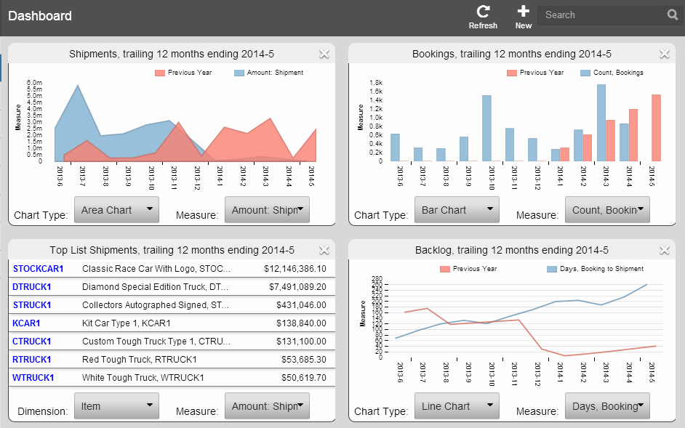
Demo: Dashboards
Custom dashboards
Setup with your choice of charts.
Charts allow choice of measures and dimensions.
Dashboards saved by user.

Slide 11
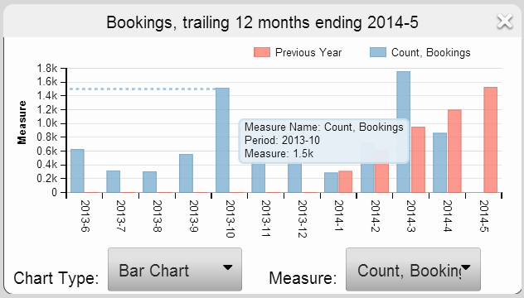
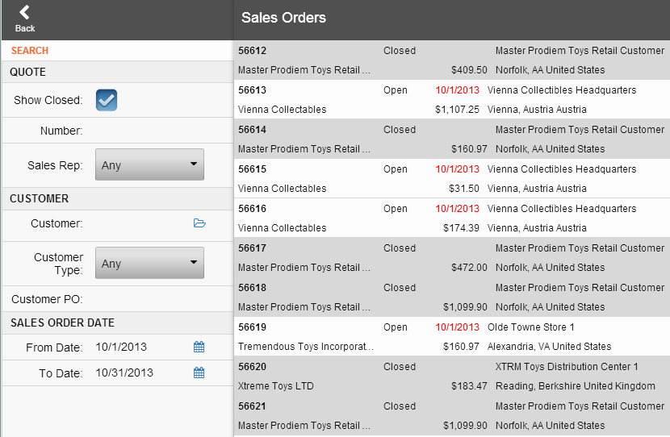
Demo: Charts
Charts support drill-down to operational data.

Slide 12
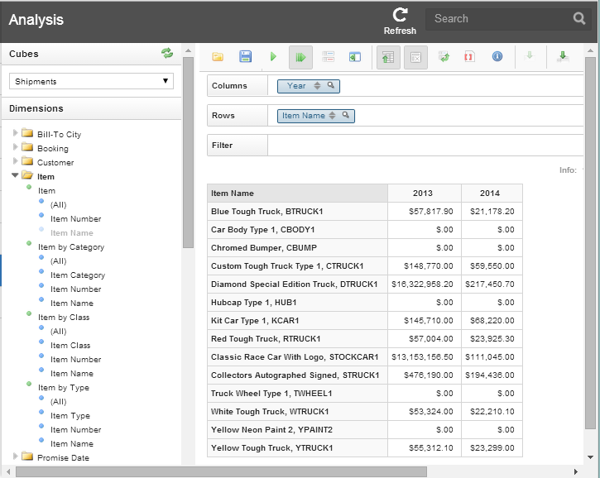
Demo: Analysis
Analysis allows you to explore data with drag and drop.

Slide 13
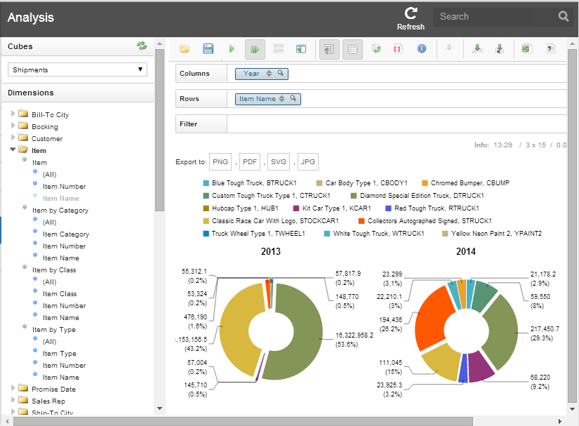
Demo: Analysis
Analysis supports popular charts to visualize data.

